Slide 1
Central Tendency and Variability
Chapter 4

Slide 2
Variability
In reality – all of statistics can be summed into one statement:
Variability matters.
(and less is more!, depending).
(and error happens).

Slide 3
Central Tendency
Definition: descriptive stat that best represents the center of a distribution of data.
Mean: arithmetic average
“Typical score”
Often described as the “middle” of the scores, so don’t confuse this with medians.

Slide 4
Calculating the Mean
Add up all scores
Divide by number of scores
Traditionally, we use M
as the symbol for sample means.

Slide 5
Note on Symbols
Usually Latin letters (normal alphabet) are used for samples
M, SD
Sample statistics
Greek letters are used for populations
μ, σ
Population parameters.
All statistical letters are italicized.

Slide 6
Central Tendency
Median: middle score when ordered from lowest to highest
No real symbol, but you can abbreviate mdn

Slide 7
Calculating the Median
Line up the scores in ascending order
Find the middle number
For an odd number of scores, just find the middle value.
For an even number of scores, divide number of scores by two.
Take the average of the scores around this position.

Slide 8
Central Tendency
Mode: most common score
It’s the value:
With the largest frequency (or percent on a table).
The highest bar on a histogram (remember that SPSS squishes categories sometimes though).
The highest point on a frequency polygon.
Note…sometimes there are multiple modes.

Slide 9
Calculating the Mode
Line up the scores in ascending order.
Find the most frequent score.
That’s the Mode!
Aka, book notes can be silly sometimes.

Slide 10
Mode + Distributions
We talked about this before but:
Unimodal = one hump distributions with one mode.
Bimodal = distributions with two modes.
Multimodal = distributions with three+ mode.
Remember we talked about traditionally how if there are 10 5s and 10 6s (that is technically two modes) that people consider that unimodal because they are so close together.

Slide 11
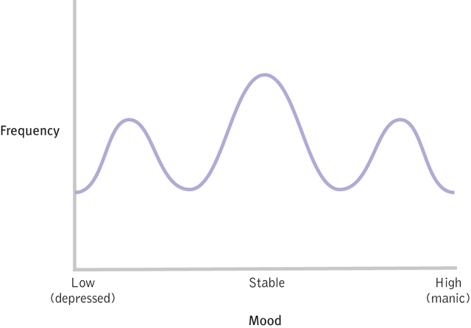
Why central tendency is not always the best answer:
Figure 4-4: Bipolar Disorder and the Modal Mood

Slide 12
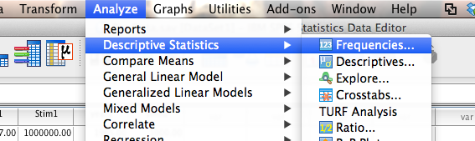
SPSS Notes
Analyze > descriptives > frequencies

Slide 13
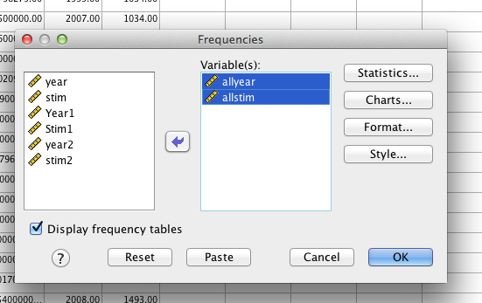
SPSS Notes
Move the variables you want to use to the right.

Slide 14
SPSS Notes
Remember that histograms are under charts.
Click statistics.
Choose the descriptives you want … here I selected mean, median, mode, quartiles, range, variance, and standard deviation (which we haven’t covered yet).

Slide 15
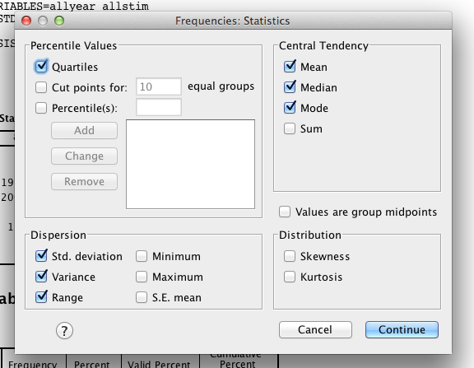
SPSS Notes

Slide 16
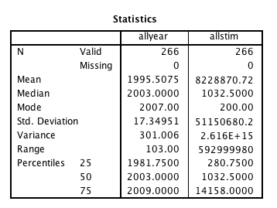
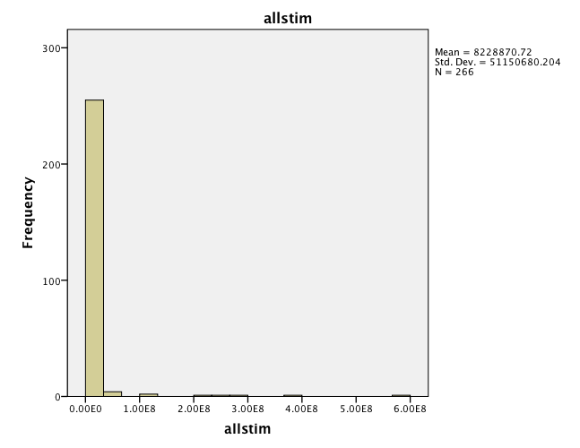
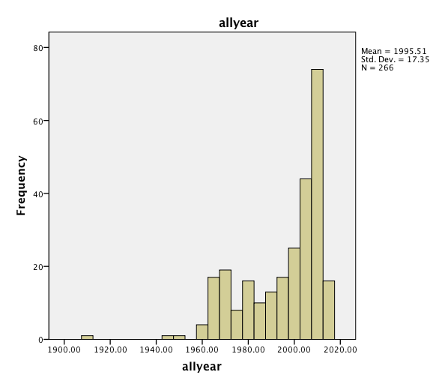
SPSS Notes

Slide 17
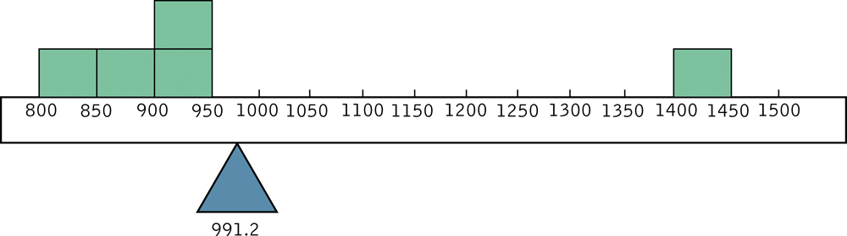
Outliers and the Mean
An early lesson in lying with statistics
Which central tendency is “best”: mean, median, or mode?
Depends!

Slide 18
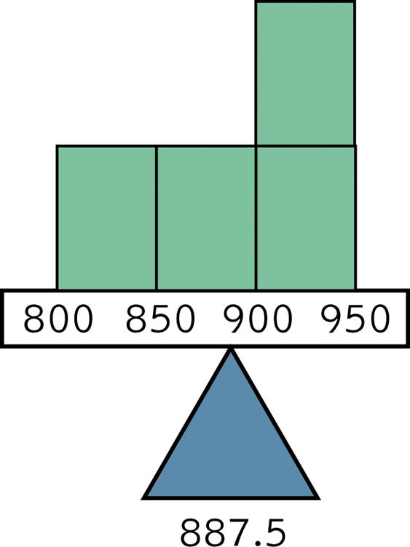
Figure 4-6:
The Mean without the Outlier

Slide 19
Test with Big Data
So what happens if we delete our outliers?
Summary:
Mean is most affected by outliers (moved up or down, can be by a lot).
Best for symmetric distributions.
Median may change slightly one number up or down.
Best for skewed distributions or with outliers.
Generally the mode will not change. Uses:
One particular score dominates a distribution.
Distribution is bi or multi modal
Data are nominal.

Slide 20
Measures of Variability
Variability: a measure of how much spread there is in a distribution
Range
From the lowest to the highest score

Slide 21
Calculating the Range
Determine the highest score
Determine the lowest score
Subtract the lowest score from the highest score

Slide 22
Measures of Variability
Variance
Average squared deviation from the mean
How much, on average, do people vary from the middle?

Slide 23
Calculating the Variance
Subtract the mean from each score
Square every deviation from the mean
Sum the squared deviations
Divide the sum of squares by N
Super special SPSS notes right here about N versus N-1.

Slide 24
Measures of Variability
Standard deviation
(square root of variance)
Typical amount that each score deviates from the mean.
Most commonly used statistic with the mean.
Why use this when variance says the same thing?
Standardized – brings the numbers back to the original scaling (since they were squared before).
Still biased by scale.

Slide 25
Calculating the Standard Deviation
Typical amount the scores vary or deviate from the sample mean
This is the square root of variance
Again, remember that SPSS uses a different denominator.

Slide 26
Practice Problem
How to get the biased estimates out of SPSS.
First we need to calculate the deviations from the mean:
Find the mean (see earlier notes about descriptives).

Slide 27
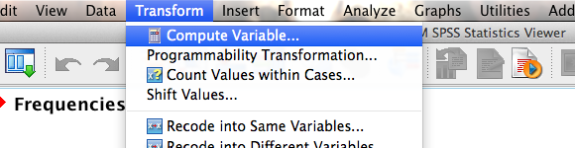
Practice Problem
Transform > compute variable

Slide 28
Practice Problem
Give the variable a name (top left).
In “numeric expression”:
Put in the variable name (double click or drag and drop).
Then the minus sign (-)
Then type the mean.
(VARIABLE – mean score you found from descriptives.) * (VARIABLE – mean score)
There’s no squared button.

Slide 29
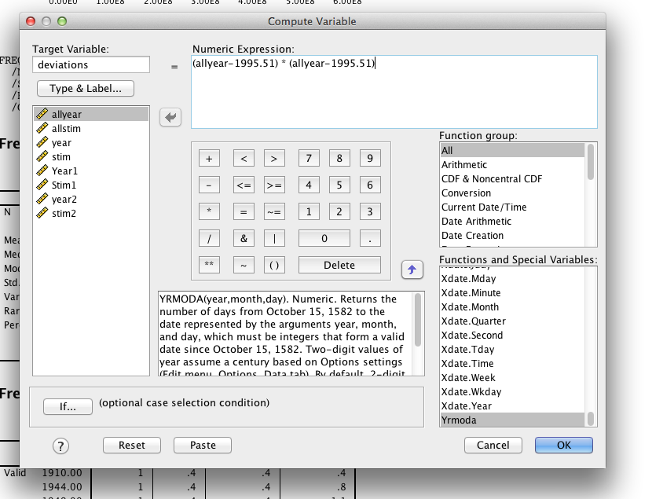

Slide 30
Practice Problem
Then find the mean of your new column using descriptives (see earlier).
The MEAN = variance
Take the square root for standard deviation.
(note: we will be able to use the var/sd automatic options in a later chapter).

Slide 31
Interquartile Range
Measure of the distance between the 1st and 3rd quartiles.
1st quartile: 25th percentile of a data set
The median marks the 50th percentile of a data set.
3rd quartile: marks the 75th percentile of a data set

Slide 32
Calculating the Interquartile Range
Subtract: 75th percentile – 25th percentile.

